Slide 1
Predicate Logic

Slide 2
Expressiveness limitation of propositional logic
KB contains "physics" sentences for every single square
For every location [x,y] B_{x,y} ⇔ (P_{x,y+1} ∨ P_{x,y-1} ∨ P_{x+1,y} ∨ P_{x-1,y})
Rapid proliferation of clauses
Predicate logic introduces variables to logic

Slide 3
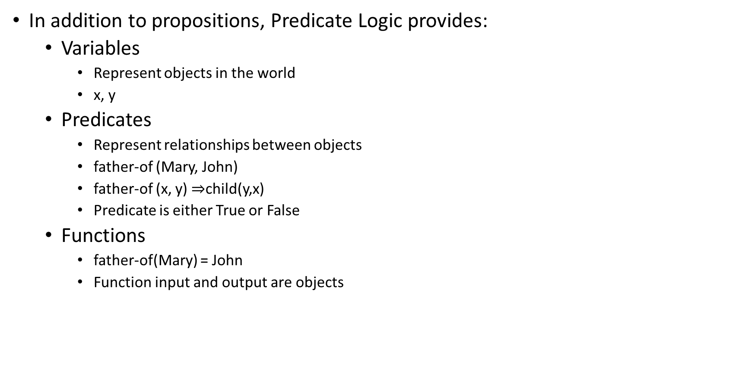
Predicate Logic or First Order Logic
In addition to propositions, Predicate Logic provides:
Variables
Represent objects in the world
x, y
Predicates
Represent relationships between objects
father-of (Mary, John)
father-of (x, y) $⇒$child(y,x)
Predicate is either True or False
Functions
father-of(Mary) = John
Function input and output are objects

Slide 4
Building a FOL sentence
Constant symbols correspond to objects (“individuals”) in the Universe
E.g., Today, Mary
Convention: begin with a Capital letter
Variable symbols represent one of the objects
E.g., x, y, z
Convention: use small letters
Function symbols
E.g., mother-of (Bill); maximum-of (x,y)
A term is either a constant or variable

Slide 5
Building a FOL sentence
Predicates
Represents a specific relationship between objects
father-of (Mary, John)
“John is the father of Mary”
An atomic sentence is a predicate (with n terms)
The truth values, True and False, are also atomic sentences.

Slide 6
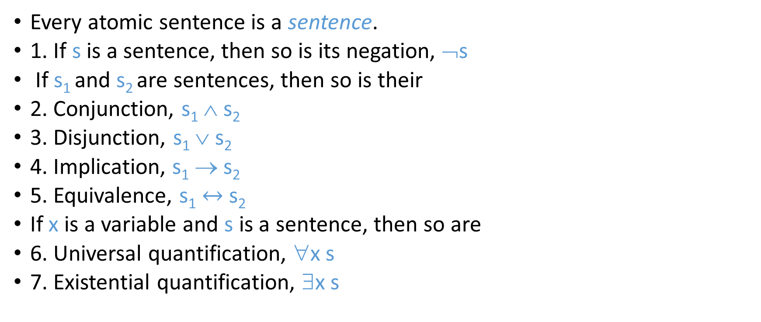
Building a FOL sentence
Every atomic sentence is a sentence.
1. If s is a sentence, then so is its negation, ¬s
If s₁ and s₂ are sentences, then so is their
2. Conjunction, s₁ ∧ s₂
3. Disjunction, s₁ ∨ s₂
4. Implication, s₁ → s₂
5. Equivalence, s₁ $↔$ s₂
If x is a variable and s is a sentence, then so are
6. Universal quantification, ∀x s
7. Existential quantification, ∃x s

Slide 7
Quantifiers
Universal quantification
∀x P(x) means that P holds for all values of x in the domain associated with that variable
E.g., ∀x dolphin(x) → mammal(x)
Existential quantification
∃x P(x) means that P holds for some value of x in the domain associated with that variable
E.g., ∃ x mammal(x) ∧ lays-eggs(x)
Permits one to make a statement about some object without naming it

Slide 8
Universal quantifiers
“All students are smart”
Define predicates: student(x), smart(x)
∀x student(x)∧smart(x)
or
∀x student(x) → smart(x)
Universal quantifiers are often used with → (implies) to form “rules”:
∀x student(x) → smart(x) means “All students are smart”
Universal quantification is rarely used to make statements about every individual in the world:
∀x student(x)∧smart(x) means “Everyone in the world is a student and is smart”

Slide 9
Existential quantifiers
“There is a student who is smart”
Predicates: student(x), smart(x)
∃x student(x) ∧ smart(x)
or
∃x student(x) → smart(x)
Existential quantifiers are usually used with ∧(and) to specify a list of properties about an individual:
∃x student(x) ∧ smart(x) means “There is a student who is smart”
A common mistake:
∃x student(x) → smart(x) to represent “There is a student who is smart”
Why? (what happens when there is a person who is not a student?)

Slide 10
Quantifier Scope
Switching the order of universal quantifiers does not change the meaning:
∀x∀y P(x,y) ↔ ∀y∀x P(x,y)
Can switch the order of existential quantifiers:
∃x∃y P(x,y) ↔ ∃y∃x P(x,y)
Switching the order of universals and existentials does change meaning:
∀x ∃f food(f) ∧ likes (x,f) “Everybody likes some food”
∃f ∀x food(f) ∧ likes (x,f) “There is a (one specific) food that everyone likes”

Slide 11

Connections between All and Exists
Can rewrite sentences involving ∀ and ∃ using De Morgan’s laws:
∀x P(x) ↔ $¬$∃x $¬$P(x)
∃x P(x) ↔ $¬$∀x $¬$P(x)

Slide 12
Translating English to FOL
Predicates
tall(x)
gardener(x)
likes(x, y)
mushroom(x)
purple(x)
poisonous(x)
teacher(x)
wears-shorts(x)
wears-tshirt(x)

Slide 13
Translating English to FOL
Clinton is not tall.
¬tall(Clinton)
Every gardener likes the sun.
∀x gardener(x) → likes(x,Sun)
All purple mushrooms are poisonous.
∀x (mushroom(x) ∧ purple(x)) → poisonous(x)
No purple mushroom is poisonous.
¬∃x purple(x) ∧ mushroom(x) ∧ poisonous(x)
∀x (mushroom(x) ∧ purple(x)) → ¬poisonous(x)

Slide 14
Classwork
Write FOL sentences representing:
There are poisonous mushrooms.
No teacher wears shorts and t-shirt.

Slide 15

Classwork
Write FOL sentences representing:
There are poisonous mushrooms
∃x mushroom(x) ∧ poisonous(x)
No teacher wears shorts and t-shirt.
$¬$∃x (teacher(x) ∧wears-shorts(x) $∧$ wears-t-shirt(x)

Slide 16
Automatic theorem proving
A proof procedure is a combination of an inference rule and an algorithm for applying that rule to a set of logical expressions to generate new sentences.
Proof by resolution

Slide 17
Proofs in propositional logic
How to prove conclusion is valid?
Truth table
Every case where the premise is true, conclusion must also be true
Proof by rules of inference
Resolution refutation algorithm
How to prove conclusion is invalid?
Truth table
Show one case where the premise is true, conclusion must also be true
Proof by rules of inference
Resolution refutation algorithm

Slide 18
Proofs in predicate logic
How to prove conclusion is valid?
Truth table
Every case where the premise is true, conclusion must also be true
Proof by rules of inference
Resolution refutation algorithm
How to prove conclusion is invalid?
Truth table
Show one case where the premise is true, conclusion must also be true
Proof by rules of inference
Resolution refutation algorithm

Slide 19
What about Time?
Is Time represented? No!
Can include time in propositions:
Explicit time: L(i,j,t) means agent at (i,j) at time t
Also: P(i,j,t) B(i,j,t)
Many more sentences: O(TN²)

Slide 20
What about Actions?
move(i ,j ,k ,l ,t)
Represents move from (i,j) to (k,l) at time t
E.g. Move(1, 1, 2, 1, 0): move from (1,1) to (2,1) at time 0
What knowledge axioms capture the effect of an Agent’s move?
move(i, j, k, l ,t) ∧ L(i, j, t) ⇒ ~L(i, j, t+1) ∧ L(k, l, t+1)
For all tuples (i, j, k, l) that represent legitimate possible moves
E.g. (1, 1, 2, 1) or (1, 1, 1, 2)
Some subtleties when representing time and actions
What happens to propositions at time t+1 compared to at time t, that are not involved in any action?

Slide 21
The frame problem
How to specify that all conditions not affected by an action are not changed while executing that action?
In predicate logic, all such static properties need to be explicitly specified for every possible action
Frame axioms
Example:
If robot moves to (x,y) and is not holding a ball, then the location of the ball does not change
What is the problem?
A very large number of frame axioms is often necessary

Slide 22
Qualification problem
How to define every possible precondition of an action
Including exceptions that might occur
Example
When robot picks up the ball, it will hold the ball unless
The robot battery runs out, or
The gripper slips, or
The ball rolls away, or
Another robot picks the ball first, or …

Slide 23
Ramification problem
How to define every possible effect of an action
Example
When robot picks up the ball, all of these are possible
The battery drains a little bit, and
The gripper is closed, and
The ball does not roll, and
No other robot holds the ball, and …

Slide 24
Knowledge engineering
Modeling the “right” conditions and the “right” effects at the “right” level of abstraction is difficult
Automated knowledge acquisition and machine learning
Intelligent systems should be able to learn about the conditions and effects
Learn from?
Data: sensor measurements (of both causes and effects)

Slide 25
Problems with inference-based planning
Solution can contain irrelevant actions
Inference is slow
Resolution refutation
Practical planners restrict the language used to represent the problem
Action Languages
STRIPS
Planning as search in state space

